Slide 1
Emerging Clouds
Session 13
Course : COSC6100001 - Cloud Infrastructure
D6825 - Samuel Philip

Slide 2
Learning outcomes
(C4) Analysis : identify problems that can be solved using cloud global infrastructure
(C2) Comprehension : group Classify real-worlds problems in accordance with cloud computing infrastructure
(C4) Analysis : analyze identifying problems and choose proper Cloud Services and Cloud Infrastructure
(C5) Synthesis : design Cloud computing architecture and infrastructure and implementation on applications

Slide 3
Outline
A Short-term Forecast
Machine Learning on Clouds
Quantum Computing on Clouds
Vehicular Clouds

Slide 4
A Short-term Forecast

Slide 5

A Short-time Forecast
Variability and conflicting requirements are disruptive qualities of cloud computing demanding new thinking in system design.
The physical infrastructure consisting of servers with different architecture and performance is constantly updated as solid-state technologies and processor architecture evolve.
New software orchestrating a coherent system view is developed every month, and the depth of the software stack is continually increasing. If cloud computing is to continue to be successful, it is very likely that new applications will emerge.
This Photo by Unknown Author is licensed under CC BY-SA

Slide 6
A Short-time Forecast
Many contradictory requirements in the design of computer clouds have to be carefully balanced.
For example, resource sharing is a basic design principle, yet strict performance and security isolation of cloud application are also critical.
To deliver cheap computing cycles, the cloud infrastructure should maximize resource utilization, while sufficient resources should be kept in reserve to respond to large workload spikes.
The system as a whole should present itself as flawless and extremely reliable though the failure rate of cheap, off-the-shelf hardware components can be fairly high.
Performance guarantees should be provided, while a mix of workloads with very different requirements will continue to dynamically share system resources.
This Photo by Unknown Author is licensed under CC BY-SA

Slide 7
A Short-time Forecast
In the last few years CSPs realized why cloud users are clamoring for heterogeneity. As a result, today's clouds have multiple types of processors and co-processors, e.g., GPUs and TPUs and clouds use solid-state disks for real-time applications.
Cloud computing will continue to have a profound influence on the very large number of individuals and institutions who are now empowered to process huge amounts of data.

Slide 8
Machine Learning on Clouds

Slide 9
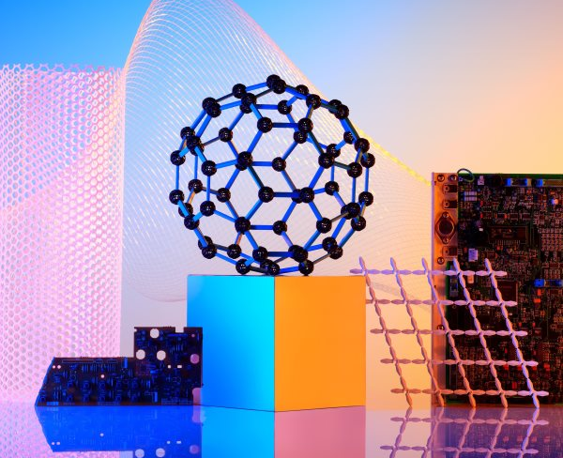
Ml on cloud
AWS Clouds ML Services
Machine learning (ML) uses algorithms that learn to discover how to perform a specific task without being explicitly programmed to do so.
Cloud provider like AWS offers some ML as their services, e.g.
SageMaker is a fully managed service that facilitates building, training, and deploying machine learning (ML) models.
SageMaker Ground Truth helps improve the quality of labels through annotation consolidation and audit workflows.
Kendra is an enterprise search service powered by machine learning.
Forecast uses machine learning to automatically discover how time series data and variables, such as product features and store locations, affect each other.

Slide 10
Quantum Computing on Clouds

Slide 11
Quantum Theory and Quantum Mechanics
It started in 1900 when Max Plank, professor at the Friedrich-Wilhelms-Universität in Berlin, postulated that electromagnetic energy could be emitted only in quantized form E=h×ν, with h Planck's constant and ν the frequency of the radiation.
Albert Einstein's elucidation of the photoelectric effect in 1905 confirmed Plank's hypothesis, and quantum theory was universally accepted. Einstein was rewarded with the 1921 Nobel Prize in Physics. Louis de Broglie developed the theory of electron waves in 1924.
The wave-particle duality principle of de Broglie was soon followed by quantum mechanics, which describes the transformation and evolution of quantum systems.

Slide 12
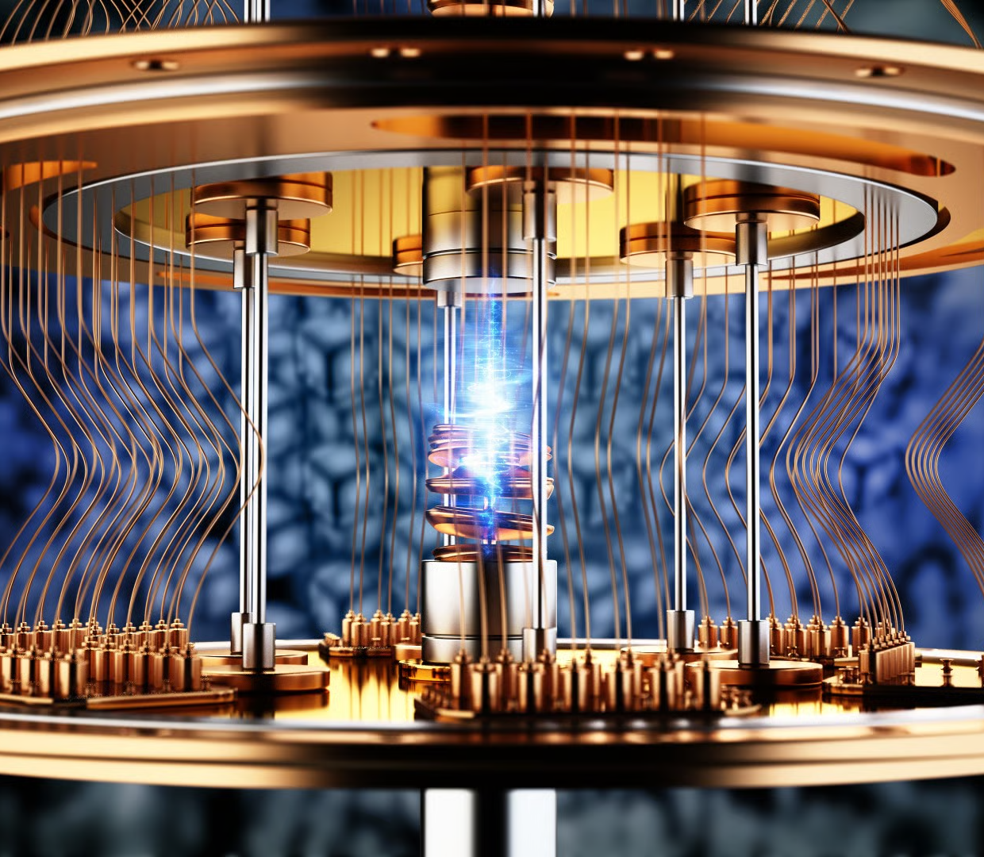
Quantum information processing
In spite of the tremendous progress in quantum information processing during the past three decades, access to quantum computers is limited and simulation of quantum physical processes can only be done using powerful classical computers, for example simulation of quantum many-body systems on the Amazon cloud.

Slide 13
Quantum Computing
To compute in a digital world, we transform the state of solid-state devices capable to perform Boolean operations as directed by a program stored in the memory of the system.
This process implies the ability to store information as the initial state of a physical system governed by the laws of classical physics and then to control the transformation of this information, i.e., the change of the system state, until we get the desired result in the shortest possible time and dissipating the least amount of energy.

Slide 14
Quantum Parallelism and Quantum Algorithms
Imagine the immensity of a 2^{n}-dimensional Hilbert space and its potential to host quantum state transformations for a quantum computation.
The implication of using qubits to process information brings us to the concept of quantum parallelism.
Given a function f(x),x∈I, assume there are N=pq elements in I, the domain of the function. A classical computer can compute a particular value of the function one at a time, i.e., f(a) for x=a. A quantum system computing f(a) will result in a superposition state including all values in the codomain of function f, i.e., f(x)∀xınI.
Another important observation is that quantum parallelism is most useful for computations requiring the values of a function for its entire domain, as is the case of algorithms using the Fast Fourier Transform (FFT)

Slide 15
Quantum Computers
To compute in a digital world, we transform the state of solid-state devices capable to perform Boolean operations as directed by a program stored in the memory of the system.
David DiVincenzo, at IBM at that time, formulated five criteria for building a useful quantum computer, plus two additional ones required for transfer of information.
Criteria on next slide

Slide 16
Quantum computers
The 5 criteria of David divicenzo
These criteria are:
  A scalable physical system with well-characterized qubits.
  The ability to initialize the qubits to a pure state |000......0〉.
  Long decoherence times, much longer than the gate operation times.
  Existence of a “universal” set of quantum gates.
  A qubit-specific measurement capability.
  Ability to interconvert “stationary” (memory) and “flying” (communication) qubits.
  Ability to faithfully transmit “flying” qubits between specified locations.

Slide 17
Cloud Access to Quantum Simulation Software
To spark interest in quantum computing among computer programmers, venture capitalists, and students wishing to explore this fascinating field, several companies support cloud access to platforms for experimenting with quantum computing. Multiple sources for information about quantum software are also available; Quantum Open Source Foundation maintains a GitHub open-source quantum software projects repository;
see https://github.com/qosf/awesome-quantum-software

Slide 18
Cloud Access to Quantum Simulation Software
The most sophisticated quantum environment is IBM Q Experience, an online platform launched in 2016. Q Experience allows general public access to a set of IBM's prototype quantum computers including two 5-qubit processors and one 16-qubit processor. A quantum system with 20 qubits is also available through the IBM Q Network;
see https://www.ibm.com/quantum-computing/

Slide 19
Cloud Access to Quantum Simulation Software
Microsoft released recently the Quantum Development Kit, replacing an earlier version called LIQUi|〉. This system includes: (i) a quantum programming language, Q#, integrated with Visual Studio development environment; (ii) simulators that run on a local system or on the Azure cloud platform; and (iii) libraries and code samples.
The software can be downloaded from https://www.microsoft.com/en-us/quantum/development-kit.

Slide 20
Vehicular Clouds

Slide 21
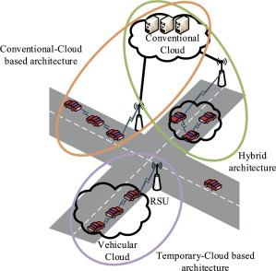
Vehicular Clouds
A vehicular cloud (VC) consists of a set of vehicles that share their computation resources through the cloud paradigm. Cooperation among vehicles and with roadside units allows on-demand scheduling of their resources.
These clouds can adapt dynamically according to the quality of service requirements of applications. Consequently, resource management represents a truly crucial for this particular kind of cloud. In this chapter, we discuss the relevant aspects of the major concepts of VCs, as well as the challenges in enabling resource management for building and maintaining such clouds

Slide 22
VC Resource management
As vehicles enter the VC, fresh compute resources become available; when vehicles leave, often unexpectedly, their resources depart with them, creating a highly dynamic environment
Ways to manage resource:
Estimating the expected number of vehicles in the VC.
Virtual machine migration in VC.
Estimating vehicular residency times.
Identifying feasible VC.
Assigning job to vehicles in VC.

Slide 23
Vehicular cloud research
challenge
Architectural Challenges.
Operational and Policy Challenges.
VC server consolidation.

Slide 24
Exercise
The use of quantum computing will be a disruption computer and network security , discuss example of it!

Slide 25
References
Marinescu, Dan C. (2022). Cloud Computing Theory and Practice: 3rd Edition. Morgan Kaufmann Publishers. ISBN: 978-0-323-85277-7
https://aws.amazon.com/ai/machine-learning/
http://link.springer.com/chapter/10.1007/978-3-319-93332-0_6

Slide 26
Thankyou

